Slide 1
Overview
What’s MTurk (and why should you care)?
Who are MTurkers?
What’s so great about MTurk ?
What’s not so great about MTurk ?
How can you get started on MTurk (and TurkPrime)?
MTurk data collected in real time

Slide 2
What’s MTurk?

Slide 3
What’s MTurk? (and why should you care?)
“Mechanical Turk”
Crowdsourcing internet marketplace created by Amazon
Large pool of constantly available people willing to complete tasks (and studies) at a low cost
Notes:
Mturk has had quite a big impact on psychology in only the past 5 or 6 years.
Typical hourly rate is $3-8 per hour ($0.50 to $1.50 for a 10 minute survey)
http://www.sciencemag.org/news/2016/06/psychologists-grow-increasingly-dependent-online-research-subjects

Slide 4
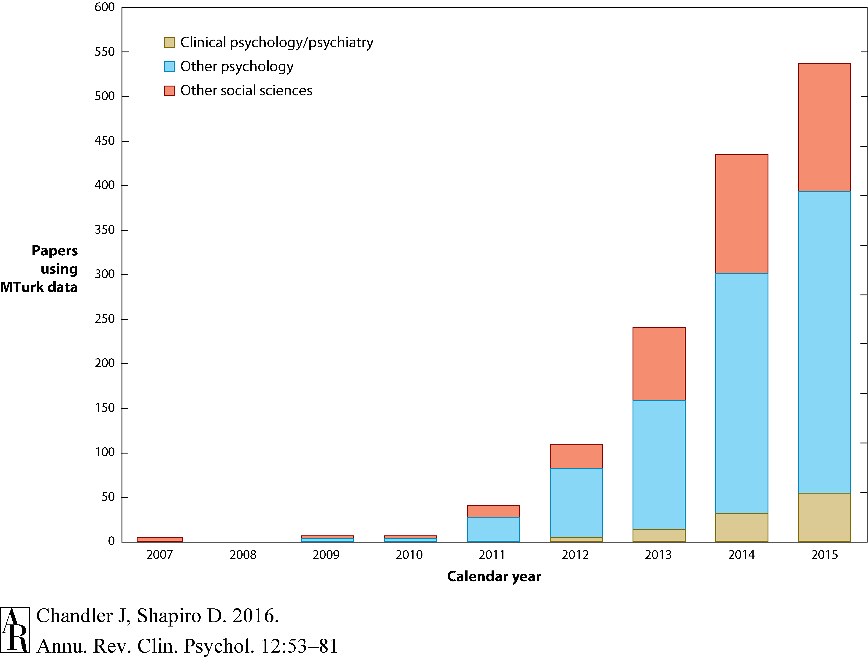

Slide 5
Who are MTurkers?
Notes:
Who are these people who are willing to take surveys for pennys on the dollar?

Slide 6
Who are MTurkers?
Amazon reports 500,000+ workers from 190+ countries
Younger (~30 year old), overeducated, under-employed, less religious, and more liberal compared to the general population
Diverse but not representative of the U.S.(though more so than a typical undergraduate sample)
Demographics: mturk-tracker.com
Berinsky, Huber, & Lenz, 2012; Paolacci & Chandler, 2014

Slide 7
What’s so great about MTurk?
Notes:
MTurk seems to be a relatively quick and cheap source of data from a diverse sample of people. But are the data any good? Can we test and replicate the kinds of phenomenon we’re interested in as psychologists? Can we trust these people to be honest?

Slide 8
What’s so great about MTurk?
Individual differences are psychometrically valid
Cognitive biases replicate
So do reaction time tasks
Self-reports of location matches IP addresses
Self-reports of demographics are consistent over time
Paolacci & Chandler, 2014
Notes:
If you have a study design that can be feasibly administered, then you can run it on Mturk. Research conducted on this population suggests…
Self-reports of individual differences are psychometrically valid
Mturkers show common cognitive biases
They respond similarly on classic cognitive tasks that rely on response-time measures
And perhaps most importantly, Mturkers tend to be honest and accurate when reporting about themselves
Self-reports of location matches IP addresses
Self-reports of demographics are consistent over time

Slide 9
What’s not so great about MTurk?
Notes:
All convenience samples of trade-offs and Mturk is no different.

Slide 10
Notes:
Using capture-recapture analysis we estimate the effective size of the active Amazon Mechanical Turk (MTurk) population that a typical laboratory can access to be about 7,300 workers. We also estimate that the time taken for half of the workers to leave the MTurk pool and be replaced is about 7 months. Each laboratory has its own population pool which overlaps, often extensively, with the hundreds of other laboratories using MTurk.
We investigated how prior exposure to a task affects subsequent experimental results. Participants in this study completed the same set of 12 experimental tasks at two points in time, first as a part of the Many Labs replication project and again a few days, a week, or a month later. Effect sizes were markedly lower in the second wave than in than in the first.
Anchoring and adjustment
Gain versus loss framing for combating disease
Sunk costs
Norm of reciprocity.
Because MTurk is a population that learns, we hypothesized that MTurkers would be more attentive to instructions than are traditional subject pool samples. In three online studies, participants from MTurk and collegiate populations participated in a task that included a measure of attentiveness to instructions (an instructional manipulation check: IMC).

Slide 11
How can you get started on MTurk (and TurkPrime)?

Slide 12
How can you get started on MTurk (and TurkPrime)?
Register with Amazon Mechanical Turk as a Requester (www.mturk.com).
Create an access key https://console.aws.amazon.com/iam/home?#security_credential
Use your new MTurk credentials to link your account with TurkPrime (www.turkprime.com)
Litman, Robinson, & Abberbock, 2016

Slide 13
Other online samples
Prolific
SocialSci
CrowdFlower

Slide 14
References
Berinsky, A. J., Huber, G. A., & Lenz, G. S. (2012). Evaluating online labor markets for experimental research: Amazon. com's Mechanical Turk. Political Analysis, 20(3), 351-368.
Chandler, J., Paolacci, G., Peer, E., Mueller, P., & Ratliff, K. A. (2015). Using nonnaive participants can reduce effect sizes. Psychological Science, 26(7), 1131-1139.
Chandler, J., & Shapiro, D. (2016). Conducting clinical research using crowdsourced convenience samples. Clinical Psychology, 12(1), 53-81.
Hauser, D. J., & Schwarz, N. (2016). Attentive Turkers: MTurk participants perform better on online attention checks than do subject pool participants. Behavior research methods, 48(1), 400-407.
Litman, L., Robinson, J., & Abberbock, T. (2016). TurkPrime. com: A versatile crowdsourcing data acquisition platform for the behavioral sciences. Behavior Research Methods, 1-10.
Paolacci, G., & Chandler, J. (2014). Inside the turk understanding mechanical turk as a participant pool. Current Directions in Psychological Science, 23(3), 184-188.
Stewart, N., Ungemach, C., Harris, A. J., Bartels, D. M., Newell, B. R., Paolacci, G., & Chandler, J. (2015). The average laboratory samples a population of 7,300 Amazon Mechanical Turk workers. Judgment and Decision Making, 10(5), 479-491.

Slide 15
Contact
Nick Michalak
Social Psychology
nickmm@umich.edu

